Slide 1

Nightshift
Turning chaotic issue queues into deterministic, explainable priority streams.
Created by Kirill Sedow, Oussema ben Younes & Nidhal Karmous

Slide 2


The Backlog Bottleneck
"Every team has a backlog nobody reads."
A backlog is a pile of unfinished work, tasks, or orders waiting to be completed. Issues arrive faster than humans can triage them, creating priority debt.
"Imagine you have a team of tireless AI developers ready to ship 24/7. But they're all staring at you asking: what should I code first? while you drown in 500 issues."
Priority order currently lives in one person's head.
The Shift: Bottleneck moved from writing code to choosing tasks.

Slide 3

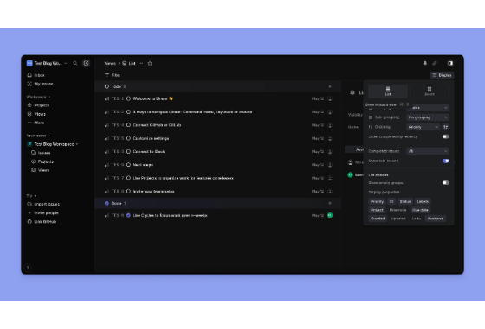
Ranking That Explains Itself
Transparency Over Black-Box AI
Auditable Point System: Eliminates random LLM hallucinations with deterministic, rule-backed scoring algorithms.
Reasoning Breakdown: Inspect exact score origins (e.g., +30 direct mention, +15 crash keyword, -10 bot).
Unified Queue: Synthesizes Slack noise, GitHub issues, and error monitoring into a single ordered stream.
Human Execution Gate: AI prepares work, human reviews and approves final pull requests.

Slide 4






How It Works: The Autonomous Loop
1. Ingest & Parse
2. Triage & Rank
3. Agent Solve
4. Human Gate
Monitors production alerts, Slack channels, and support tickets to auto-create structured GitHub issues.
Evaluates severity, user impact, and effort, attaching explicit score labels directly to each issue.
AI agents pick top-ranked tasks, create isolated Git worktrees, write code, run unit tests, and open clean PRs.
Developers review ready-to-merge PRs. 1-click approve or dismiss—zero autonomous merges without oversight.

Slide 5


Explainable Priority Formula
Signal Scale & Weights (1–5)
Deterministic Triage Benefits
Severity (W=12): 5 = System Crash | 3 = UX Bug | 1 = Typo
✓ Zero LLM latency or costly tokens during initial ranking
Impact (W=8): 5 = All Users | 3 = Edge Case | 1 = Internal
✓ 100% reproducible and customizable team rulebook
Effort (W=4): 5 = Multi-File Refactor | 1 = Single-Line Fix
✓ Output tag attached to GitHub: score:84 sev:4 imp:5

Slide 6
Before vs. After Nightshift
Dimension | Traditional Backlog | Nightshift Triage Engine
Priority Ordering | Trapped inside one lead dev's head | Transparent, mathematical, & auditable labels
Triage Time | Hours spent reading & categorizing issues | Sub-second automated evaluation & ranking
Agent Bottleneck | AI agents idle waiting for human directives | Agents continuously pull top-scored tasks
Human Role | Manual reading, organizing, and task dispatch | Strategic gatekeeper approving pre-built PRs
Backlog Health | Stale, forgotten issues decay over months | Active, prioritized queue aligned with impact

Slide 7
Questions & Discussion
Shift your engineering bottleneck from choosing tasks to shipping solutions.
Kirill Sedow | Oussema ben Younes | Nidhal Karmous

Slide 8


Image Sources
https://media.istockphoto.com/id/2009915566/photo/annoyed-developer-exasperated-after-failing-to-remove-all-bugs-while-coding.jpg?s=170667a&w=is&k=20&c=N2kGbx39yFtqS7Tw7d57N1s4kS9peX1rwyQgwm2FBNQ=
Source: www.istockphoto.com
https://cdn.prod.website-files.com/64f6d2ace102eb12e147f7a6/69a5638ec90e29fae7a3dab4_6822f732fd15d07761229c19_cleanshot_2025_05_12_at_18_24_00_2x_2x.webp
Source: www.morgen.so

